Slide 1
NSCC Accessibility Plan Evaluation Elaine da Silva (DA) April 2025

Slide 2
The Project

Slide 3

Rationale
Commitment to
Accessibility & Equity
This project aligns with NSCC’s commitment to equity, inclusion, and accessibility, recognizing accessibility as a social justice issue. By evaluating the 55 commitments in the NSCC Accessibility Plan, the institution ensures compliance with the Nova Scotia Accessibility Act and the Post-Secondary Accessibility Framework.

Slide 4
Scope
In Scope | Out of Scope
Data Collection & Validation: gathering data from department leads on accessibility initiatives (excel spreadsheet). | Creating new data sources: The project will use existing reports and stakeholder input but will not generate new data collection systems.
Data Analysis & Reporting: Analyzing qualitative and quantitative findings to identify which data is available (excel spreadsheet). | Implementing new measures: The project will provide the accessibility performance, but actual changes will be planned and executed separately.
Final Report Submission: Delivering a structured performance report based on the spreadsheet data. | Decision-making on future accessibility plans: The project will provide the report, but approval and execution of changes will be handled by NSCC leadership.

Slide 5

Goals
Goals | Expectations | Real outcomes
Evaluate the Accessibility Plan Performance | Measure the status of the 55 commitments in the NSCC Accessibility Plan (2022-2025) | Improved Accessibility Planning
Storytelling & Insights | Develop a narrative derived from the MS Forms submissions and the Survey results from the accessibility feedback process. | No structured or reliable data to tell a story.
Promote Institutional Transparency. | Communicate findings to stakeholders to ensure accountability. | Reporting on accessibility progress

Slide 6
Deliverables
Deliverable | Description | Planned | Realized
Project Charter | Formal document outlining the project’s goals, scope, stakeholders, and execution plan. | Feb 7, 2025 | Feb 7, 2025
Data Gather, Compilation and Analysis | Gather reports from department leads and validate data accuracy. Compiled and validated data on the 55 key commitments (spreadsheet). | Feb 14, 2025 | Feb 14, 2025
Draft Report | Report outlining findings. It includes just the data from the spreadsheet. | Feb 21, 2025 | Feb 21, 2025
Final Report | Approved and finalized version of the accessibility evaluation report. | Feb 28, 2025 | Feb 28, 2025

Slide 7
Schedule
No. | Milestone | Completion Date
1 | Project Kickoff | Jan 31, 2025
2 | Project Charter | Feb 7, 2025
3 | Data Gather, Compilation and Analysis | Feb 14, 2025
4 | Draft Report | Feb 21, 2025
5 | Final Report | Feb 28, 2025
6 | Report adjustments (layout, color palette, filters, etc) | Apr 08, 2025

Slide 8
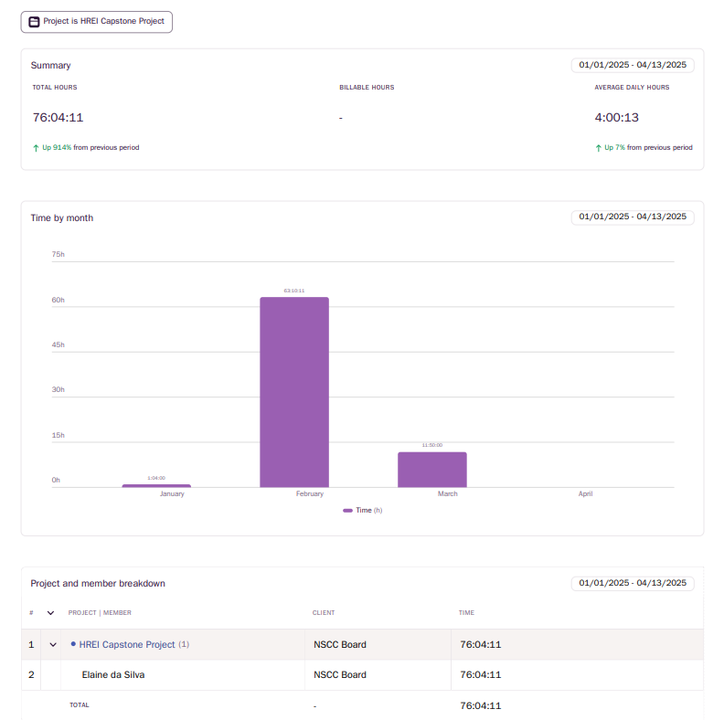
Toggl Report

Slide 9

Tools
Planned | Realized
Visio | Not used
Excel | Excel
Surveys results | Not used
Power BI | Tableau
- | Python

Slide 10
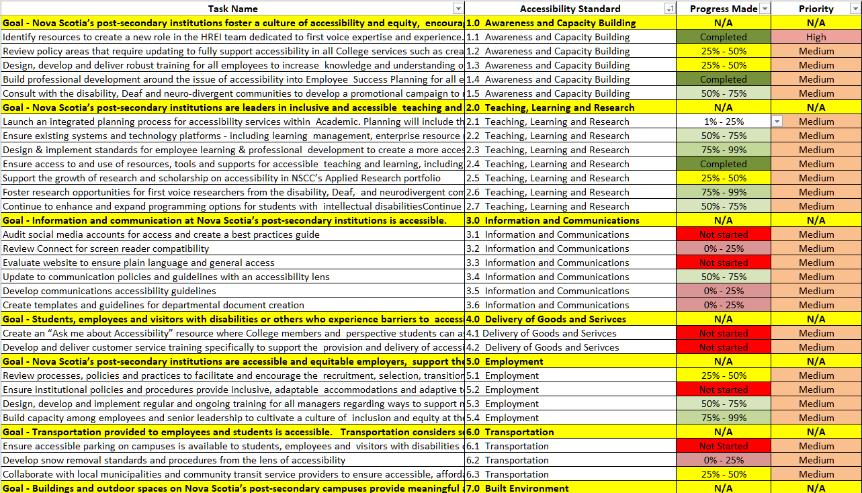
Datasources
Spreadsheet with the 55 commitments (raw data)

Slide 11
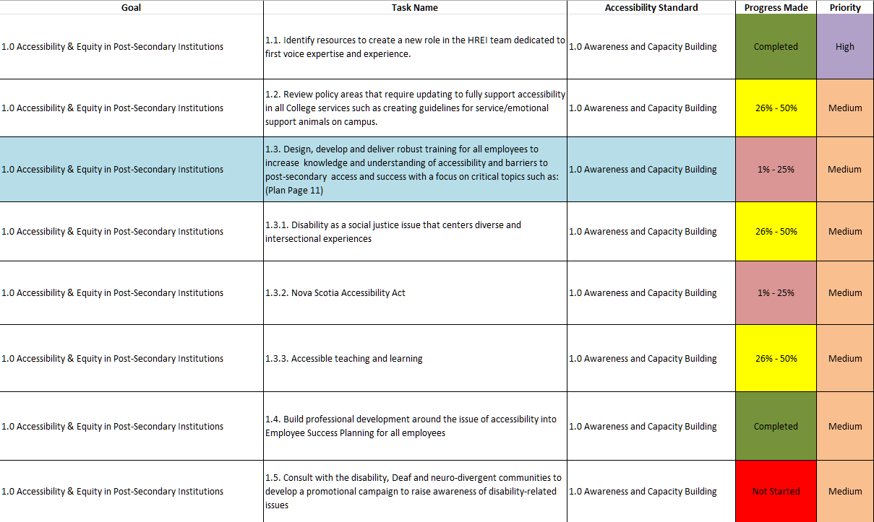
Datasources
Spreadsheet with the 55 commitments (cleaned)

Slide 12
Events and Lessons Learned

Slide 13
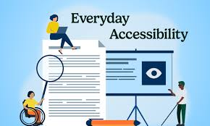
Challenges Faced
Limited data: the only source available was a spreadsheet listing 55 initiatives and some internal survey results.
Limited deadline: the final report should be delivered in three weeks.
The survey data was unstructured, expressed in free text, making it difficult to extract reliable insights in a short period of time.
The developers left the project early, discouraged by the lack of clear results.

Slide 14
Overcoming Obstacles
After initial discomfort, I adjusted my expectations and focused on what could be done well with the available data.
I chose Tableau Public because it allows online publishing without needing a corporate account.
The project was reframed as an analysis of the accessibility plan based on the 55 commitments.

Slide 15
Lessons Learned: hard skills
I learned to use Tableau from scratch.
I gained a better understanding of the pros and cons of Tableau vs. Power BI.

Slide 16
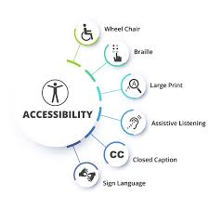
Lessons Learned: soft skills
Understanding Accessibility in Nova Scotia and NSCC.
Aligning clear expectations from the beginning is essential to success.
Defining a precise scope and setting measurable criteria before initiating data analysis.
Avoid making assumptions unless they can be supported by the available data.

Slide 17
Deliverables

Slide 18

Project Charter

Slide 19
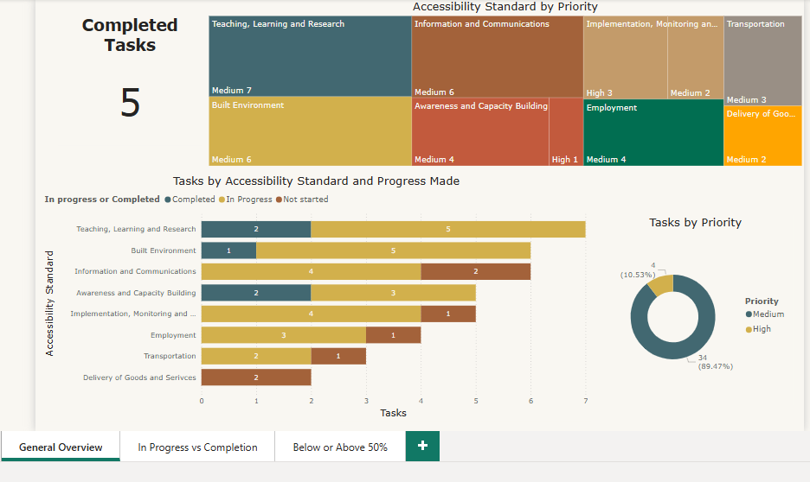
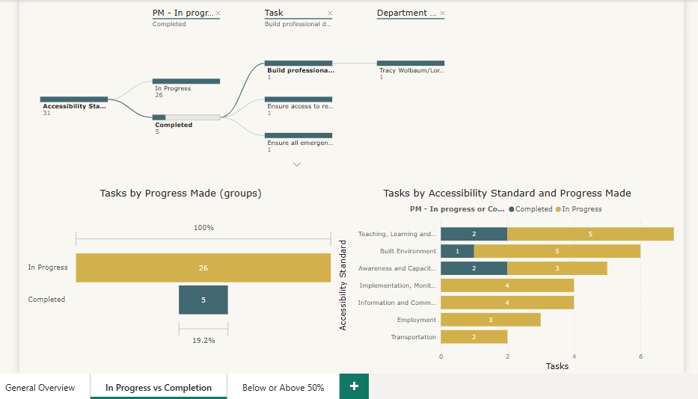
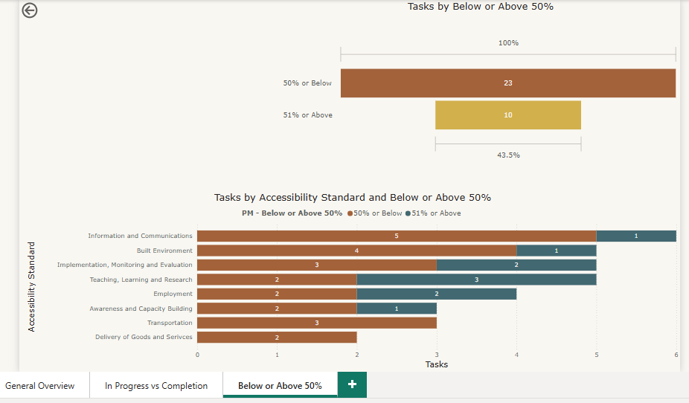
Draft version in Power BI

Slide 20
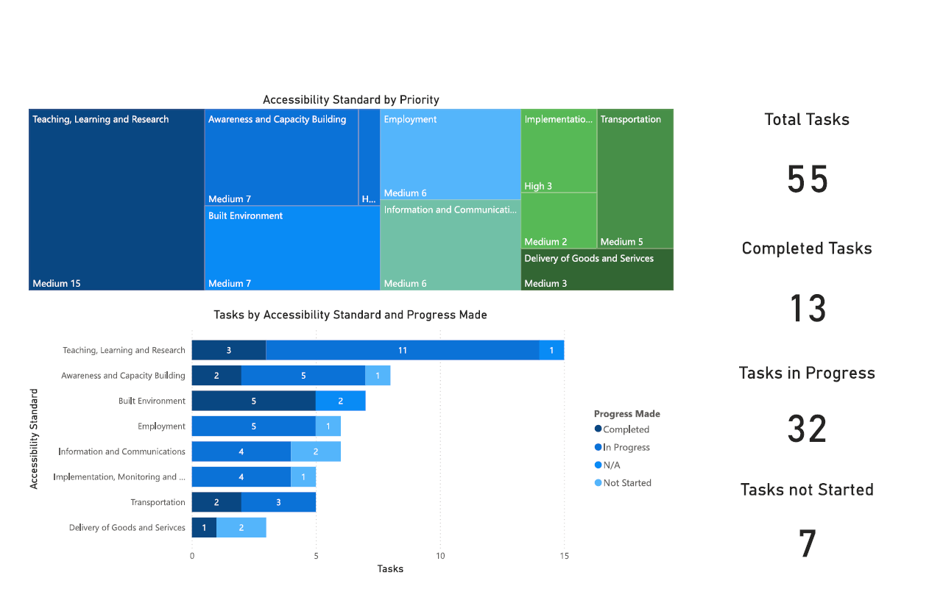
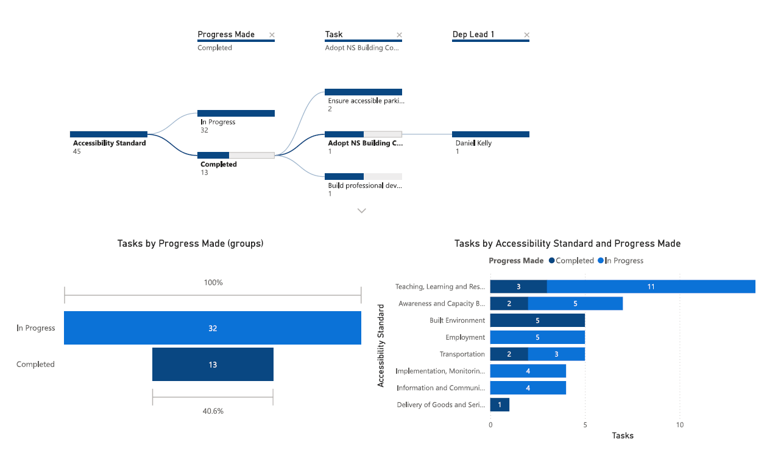
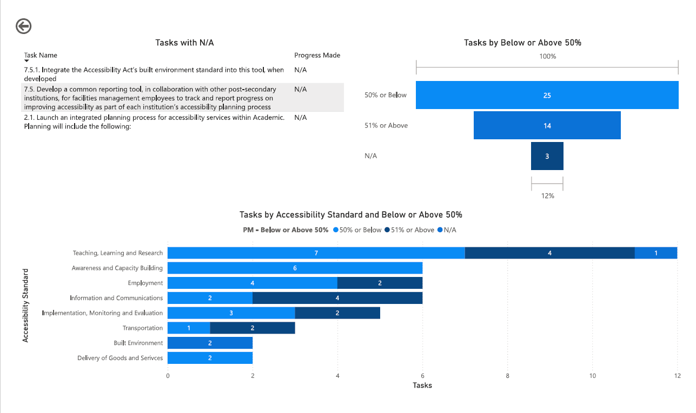
Draft version in Tableau

Slide 21
Adjustments
The report will be inserted into a larger one (word/pdf).
It was expected to be one (maximum two) pages.

Slide 22
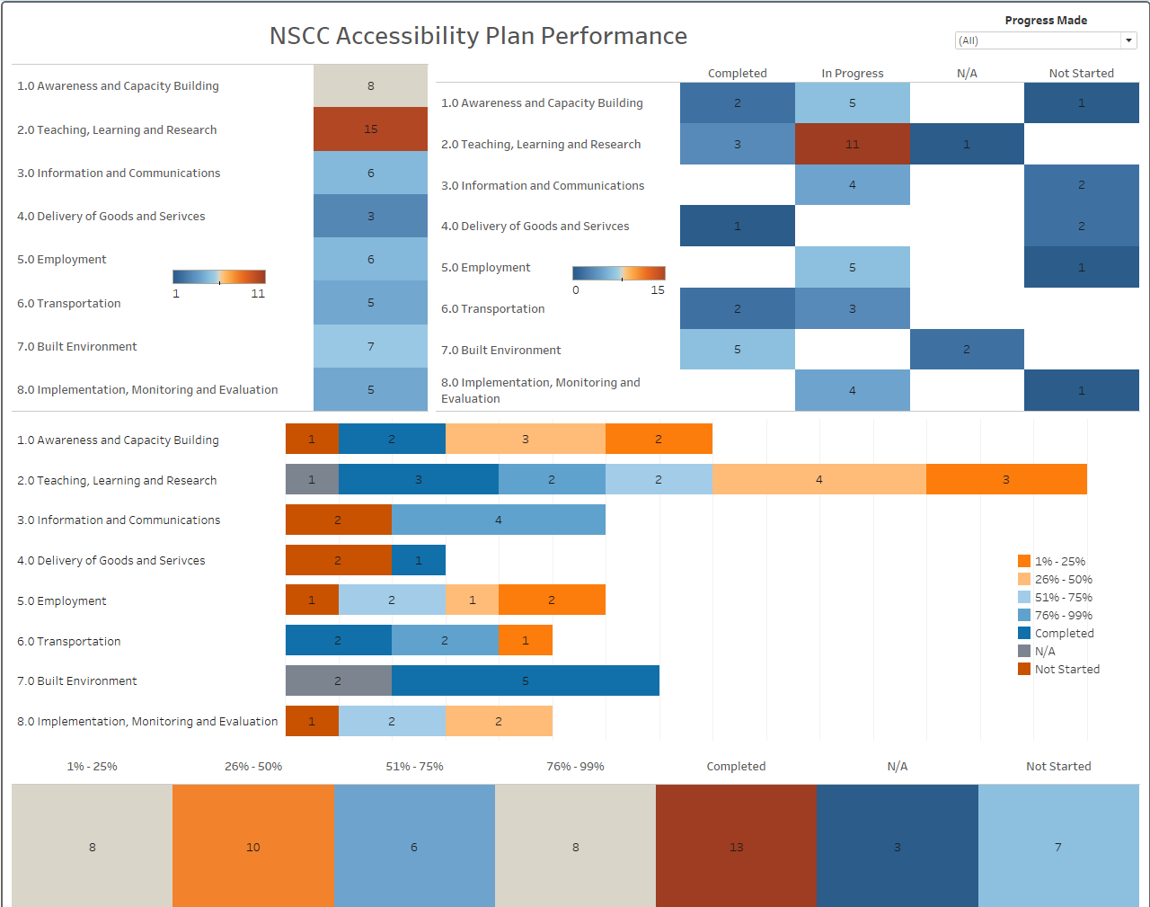
Version 2 (one page)
Landscape layout
Accessible color palette (blind color)
Tableau

Slide 23
Adjustments
Report will be printed, so dark colors should be avoided.
Portrait layout.

Slide 24
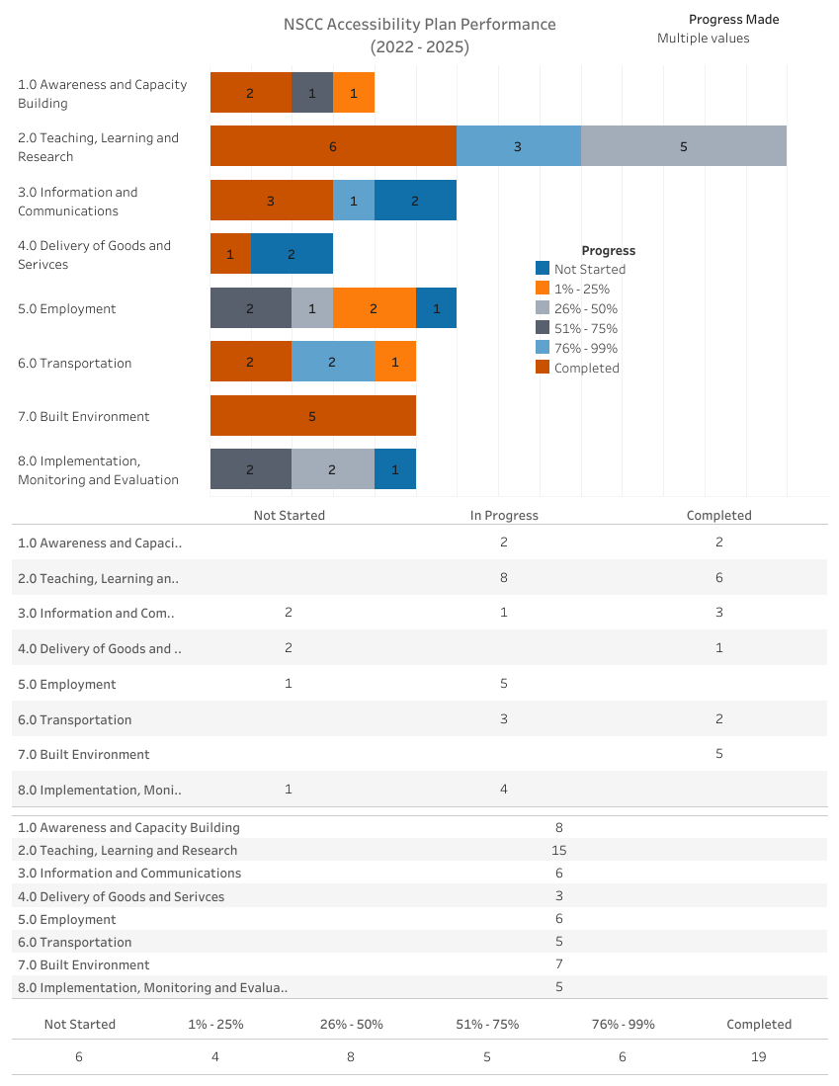
Option 1 (original)
Option 1

Slide 25
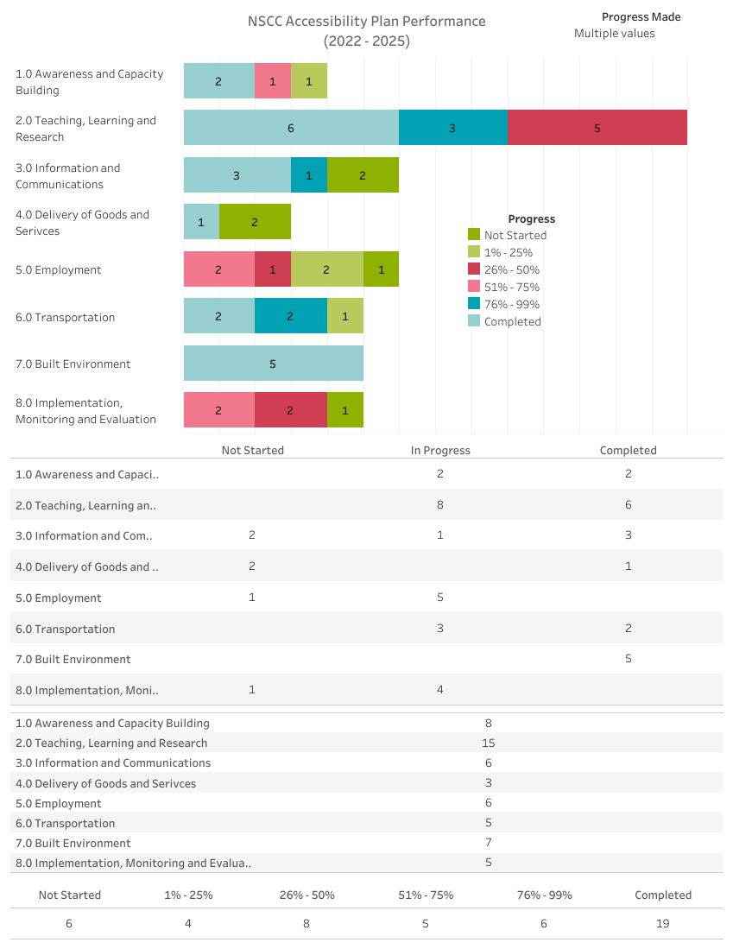
Option 2 (summer)
Option 2

Slide 26
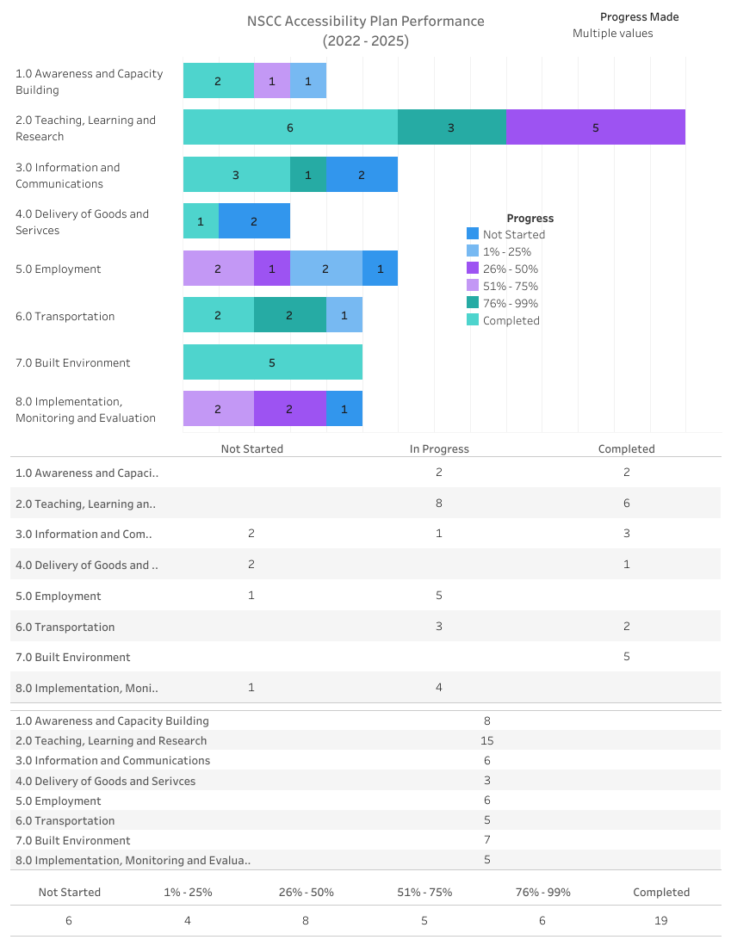
Option 3 (lightning light)
Option 3

Slide 27
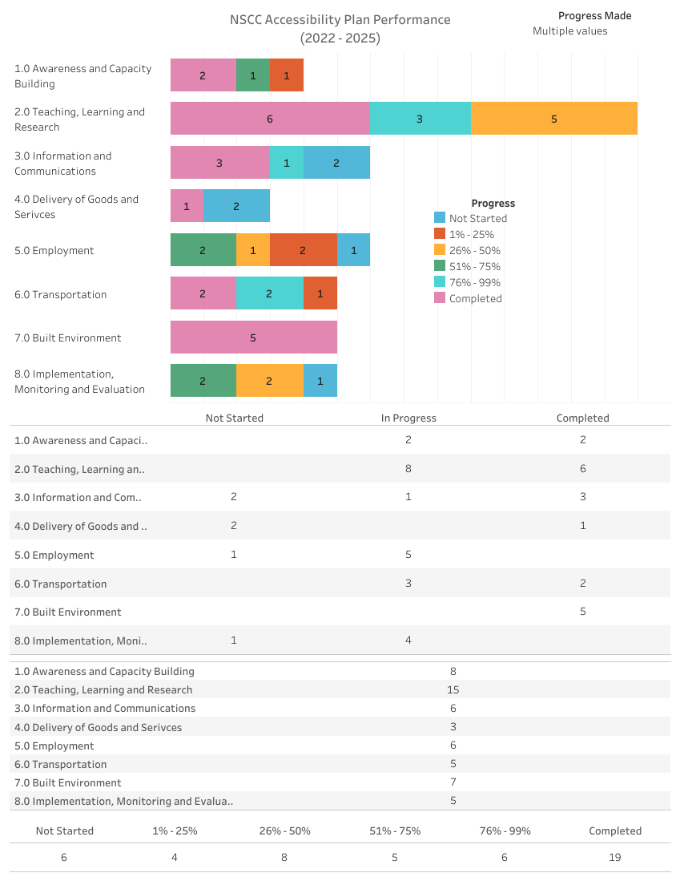
Option 4 (lightning default)
Option 4

Slide 28
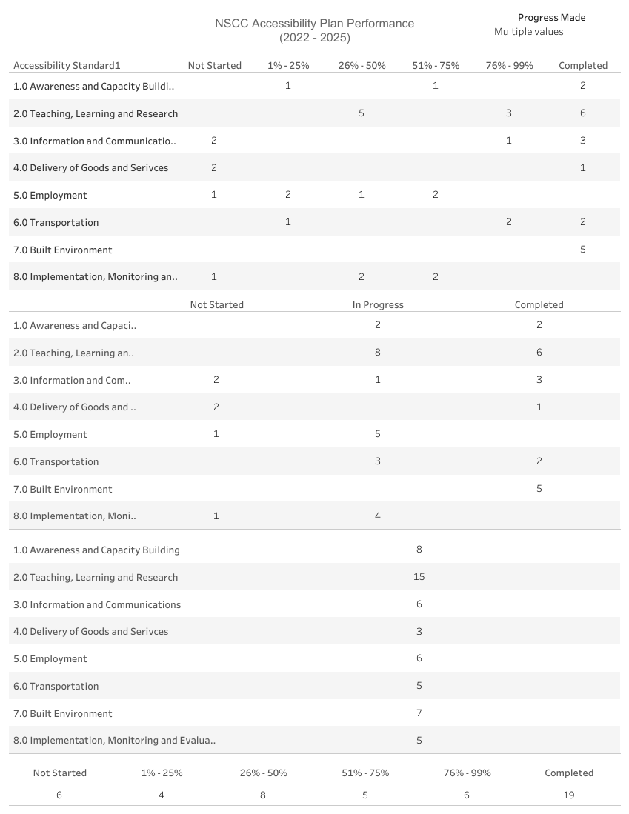
Option 5 (no color)
Option 5

Slide 29
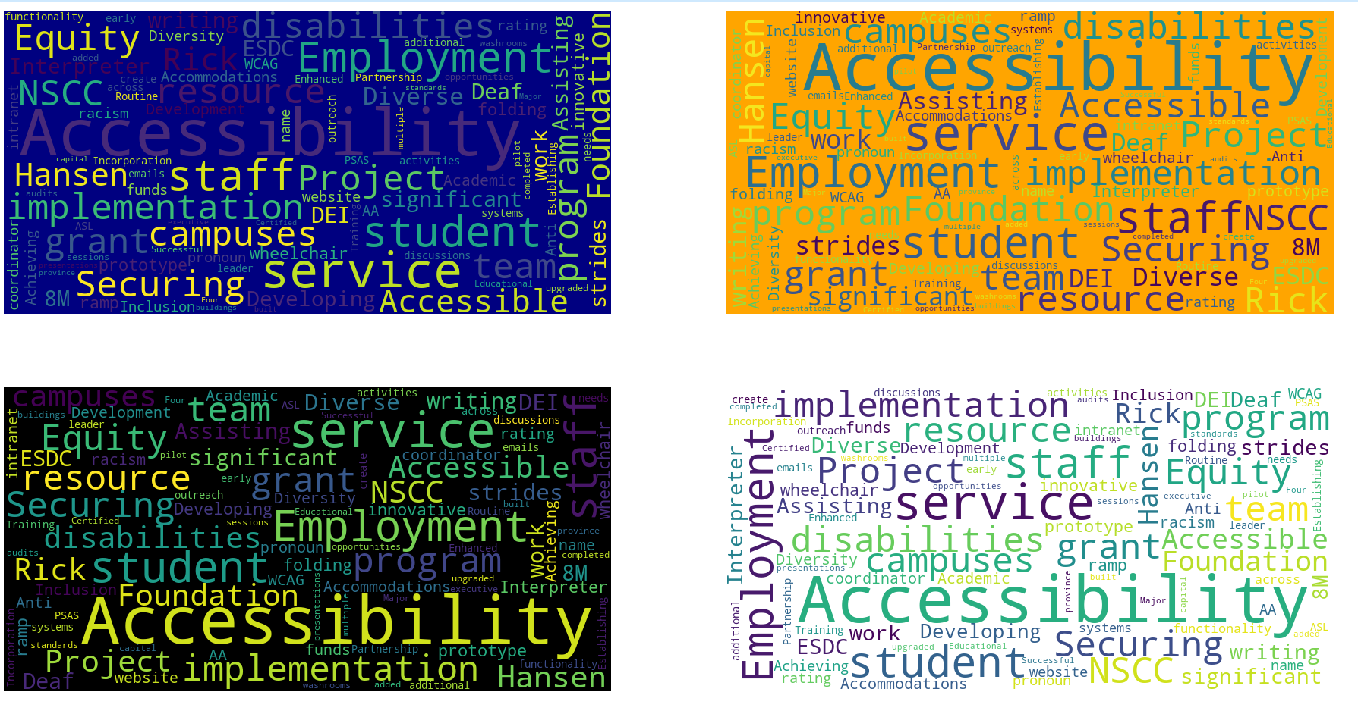
Word Cloud options
Built in Python
Based on the “celebrations” text file

Slide 30
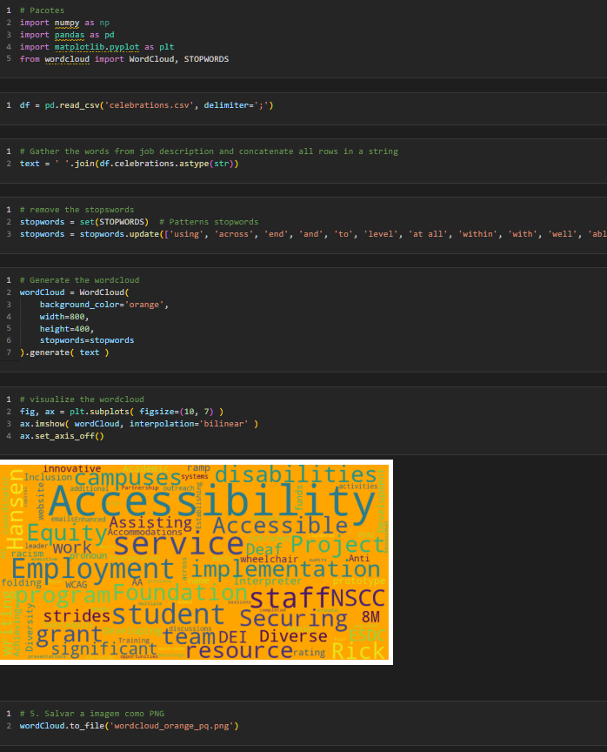
Python code

Slide 31
What’s next?

Slide 32

Next Steps
Develop the 2025-2028 plan using more specialized tools for project management, such as MS Planner or MS Lists.
Use this structure as a live database to create dashboards in Power BI.

Slide 33
Thank you

